Slide 1
NAAN MUDHALVAN SCHEME
FUNDAMENTALS DATA LITERACY WITH TABLEAU
PROJECT TITLE: Political juggernauts –A Quantitative Analysis
of candidates in the 2019 Lok sabha Election
TEAM ID : NM2023TMID16209

Slide 2
TEAM LEAD ID:
B57DFF12291BE1984D547A85262B9765
TEAM MEMBERS ID:
200A0B8EF994EB9A68744422B5950351
6A09BEE00C77022B41B457C097080778
D561D665C3D99E293594BBF904384894
4160DAA6A3FEA7691BC4D08EE0EE6143

Slide 3
INTRODUCTION:
The lok sabha is composed of representatives of people chosen by direct election on the basis of universal Adult suffrage. The constitution of india allows for a maximum of 550 member in the house, with 530 members representing the states and 20 representing the union Territories. The 17th lok Sabha was formed by the members elected in the 2019 Indian general election. Election, all across India , were conducted in seven phases from 11 April 2019 to 19 May 2019 by the election commission of India .
The Bharatiya Janata party recived 37.36%
Of the vote the highest vote share by a political party since the 1989 general election , and won 303 seats further

Slide 4
Increasing its substantial majority. In addition , the BJB –led national Democratic Alliance (NDA) won 353 seats.

Slide 5
EMPATHY MAP AND BRAINSTORMING

Slide 6
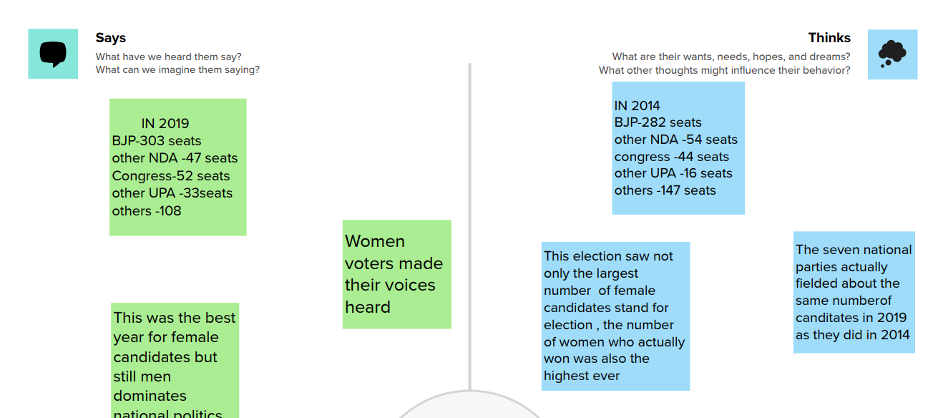

Slide 7
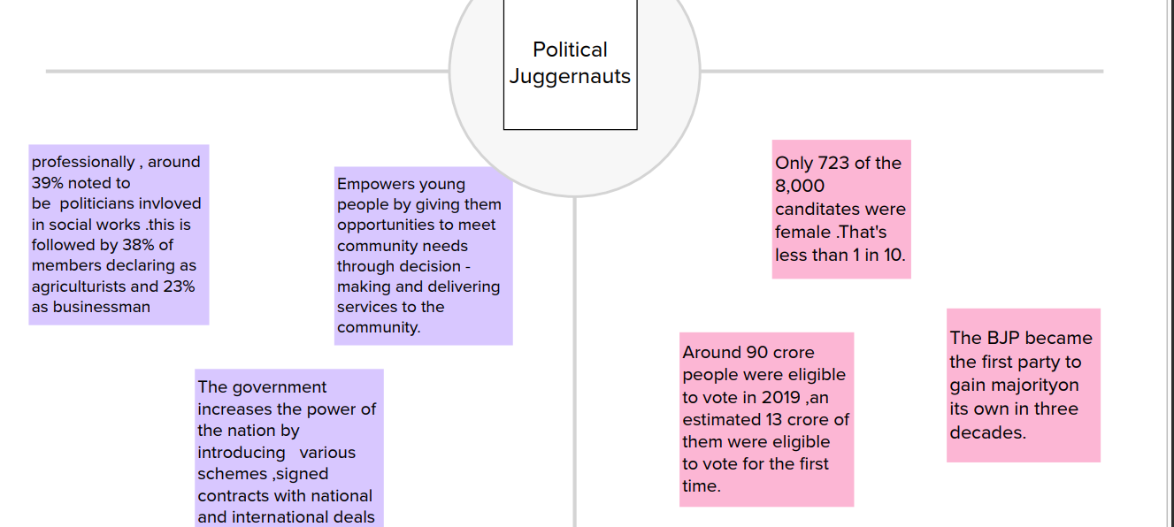

Slide 8
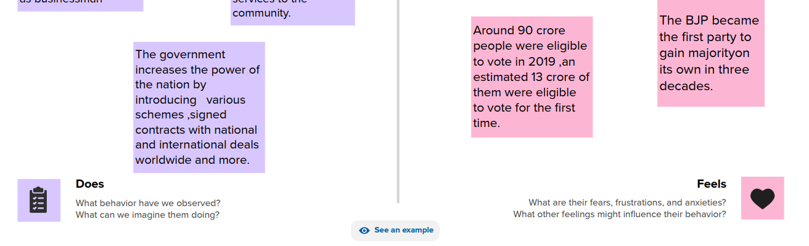

Slide 9
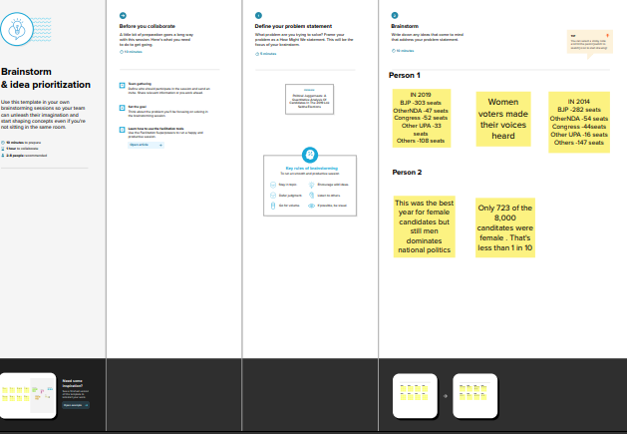

Slide 10
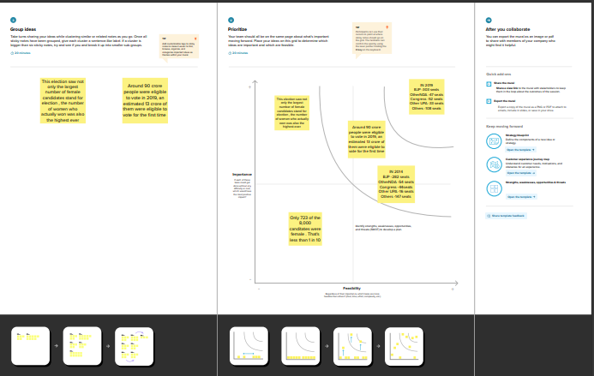

Slide 11
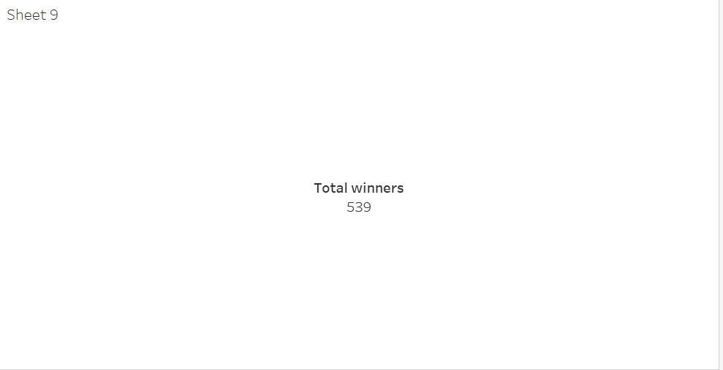
TOTAL WUNNERS

Slide 12
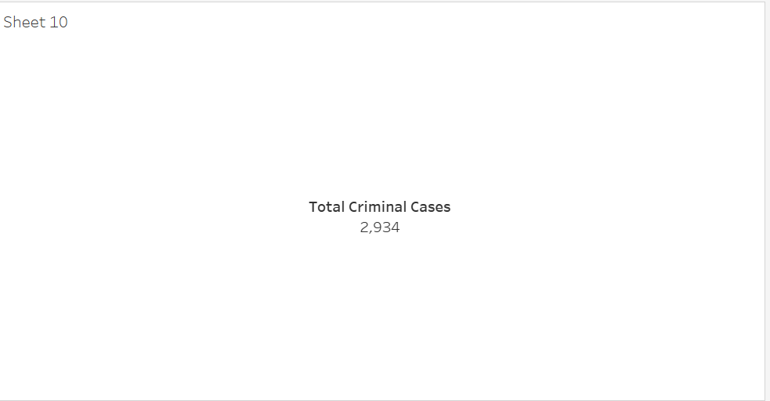
TOTAL CRIMINAL CASES

Slide 13
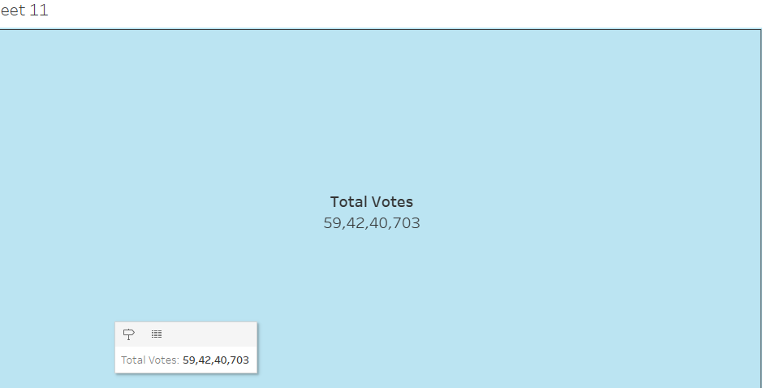
TOTAL VOTES

Slide 14
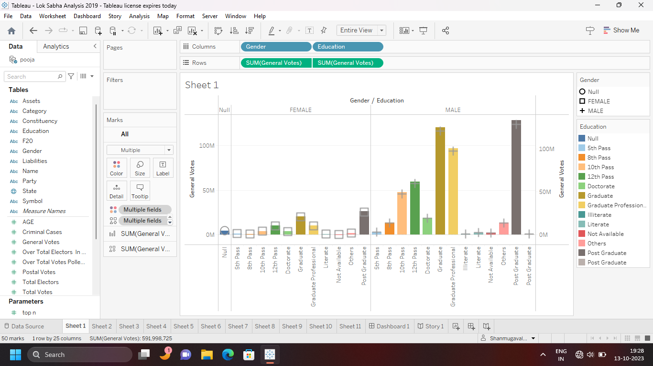
Gender & educational wise General votes

Slide 15
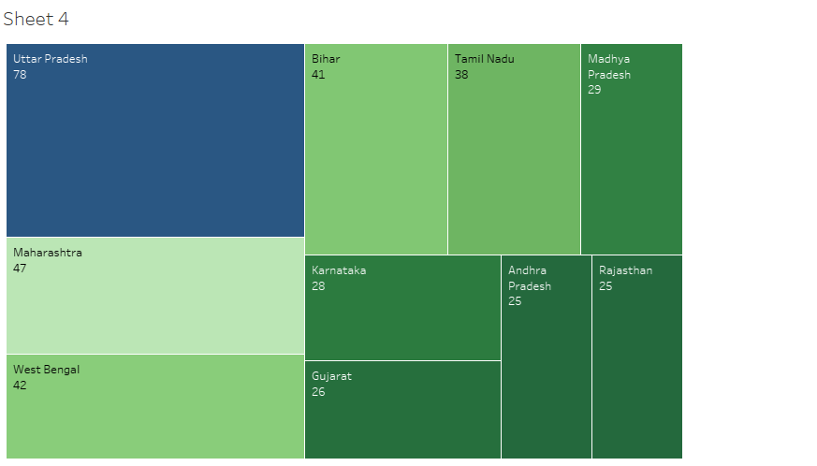
State Wise Winner:

Slide 16
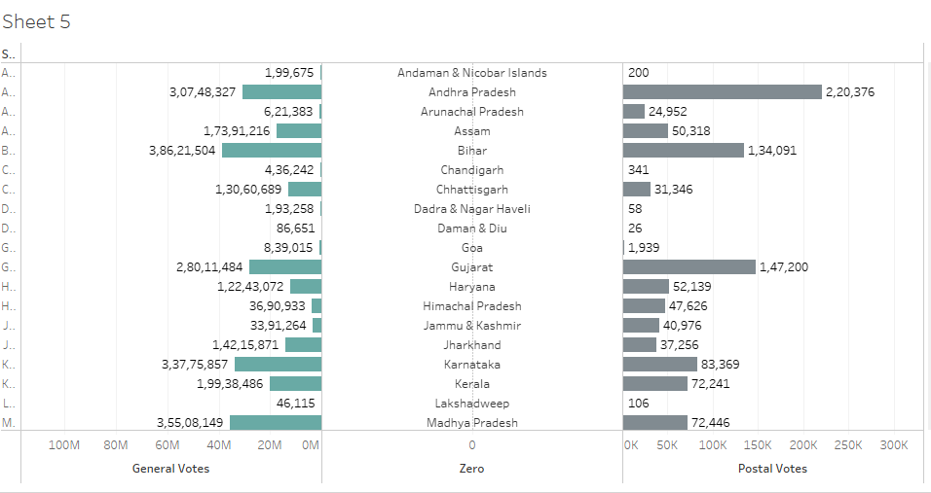
State Wise General Votes and postal Votes

Slide 17
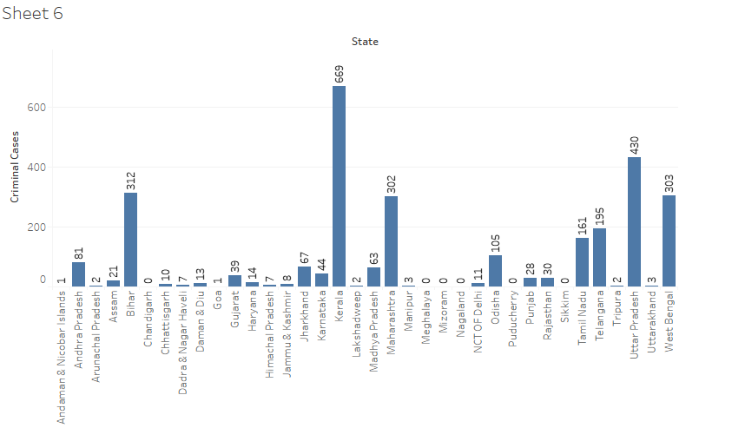
State wise Criminal cases

Slide 18
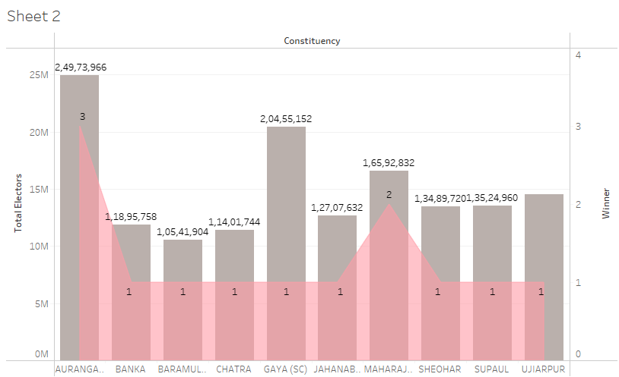
Constituency wise Winners and Eletors

Slide 19
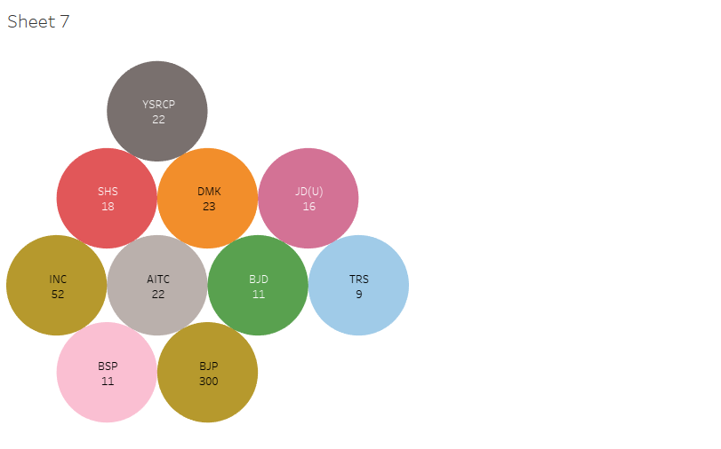
Party Wise Winners

Slide 20
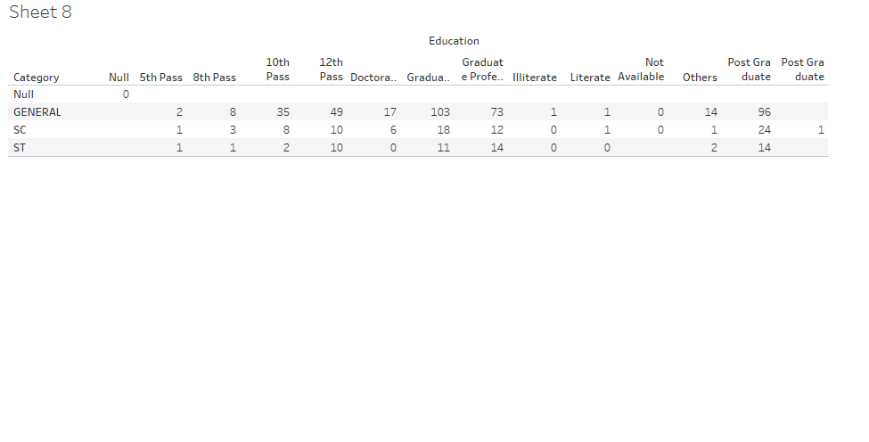
Winners by Education and category

Slide 21
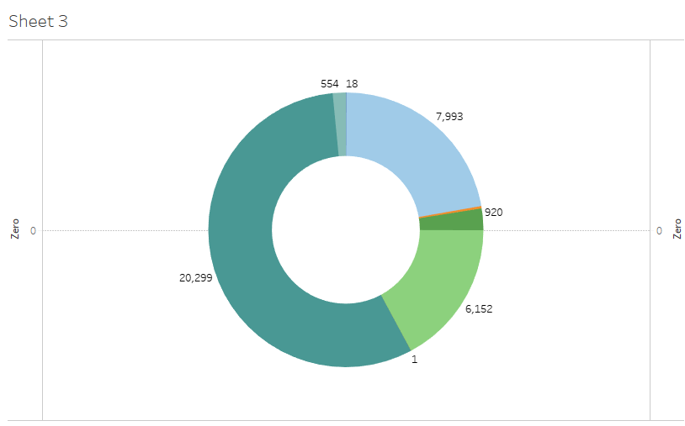
Party Wise Postal Votes

Slide 22
DASHBOARD

Slide 23
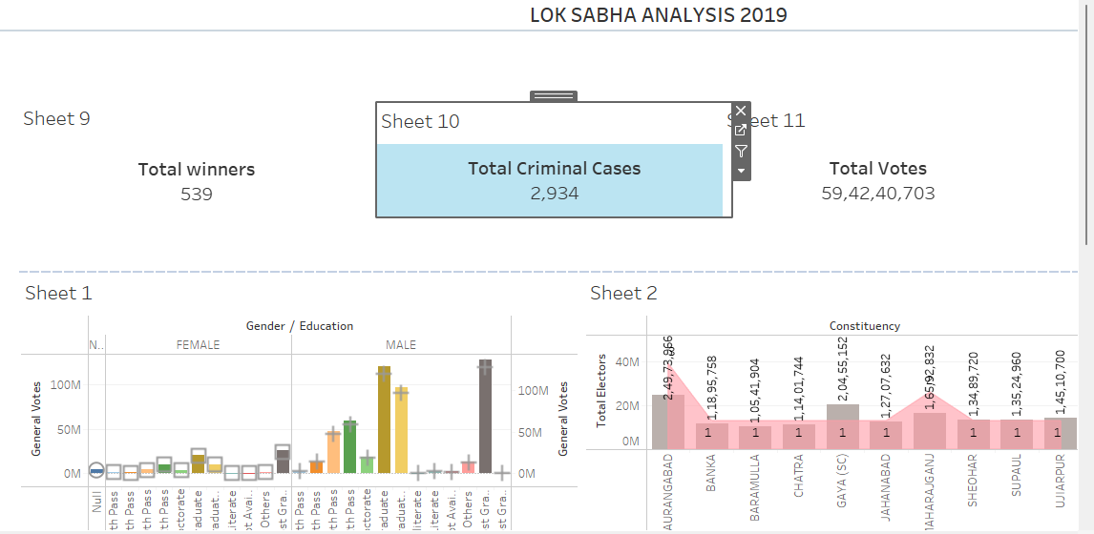

Slide 24
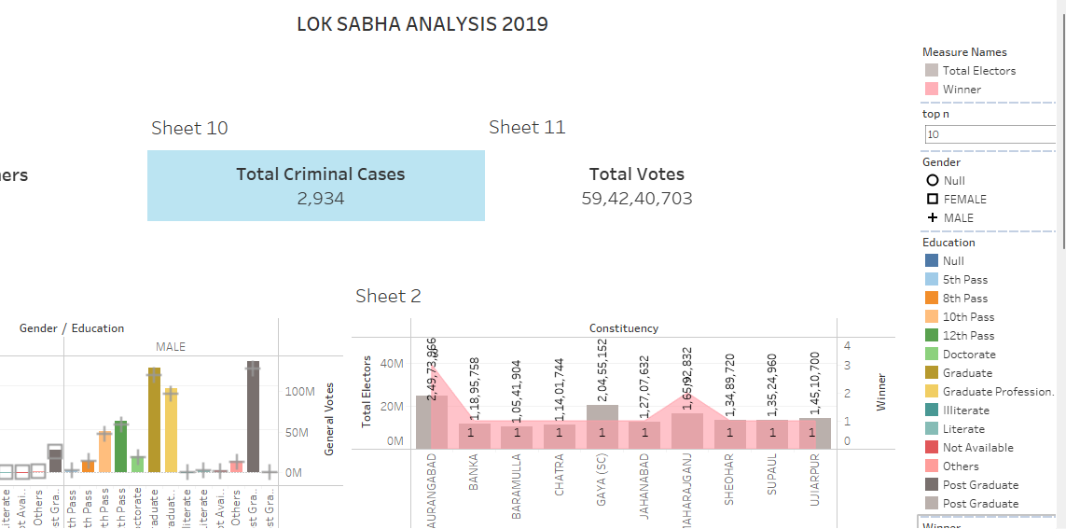

Slide 25
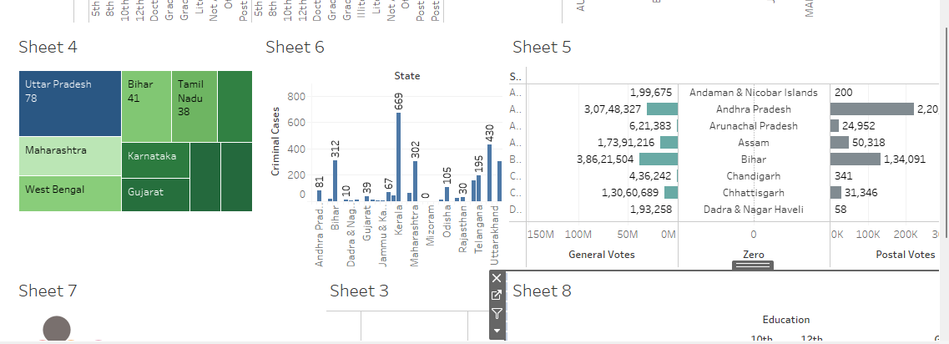

Slide 26
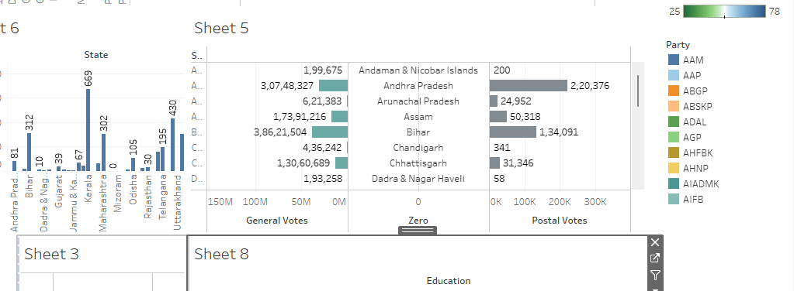

Slide 27
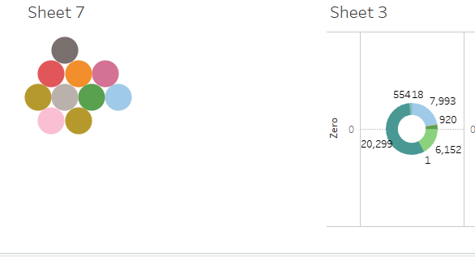

Slide 28
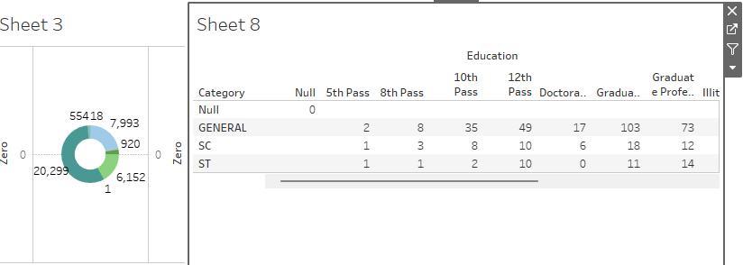

Slide 29
STORY

Slide 30
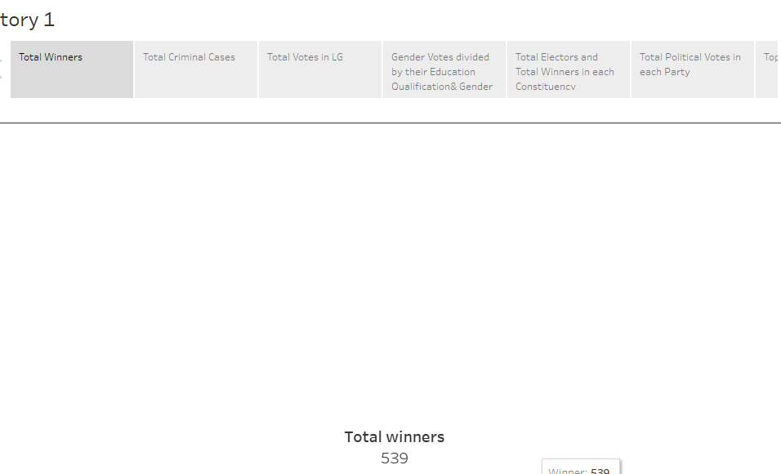

Slide 31
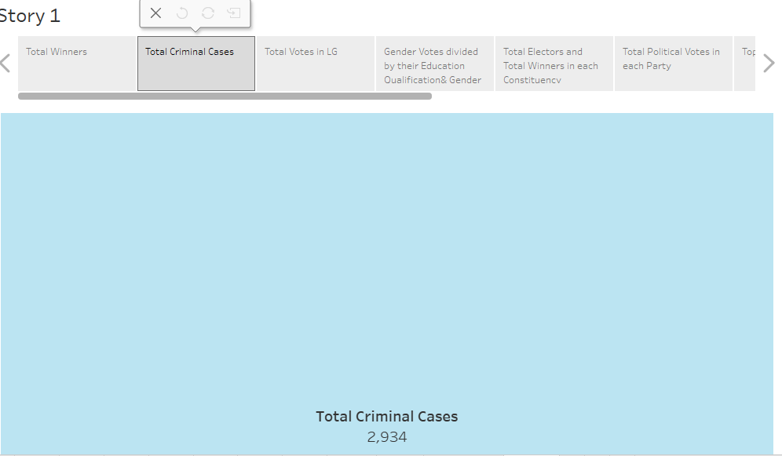

Slide 32
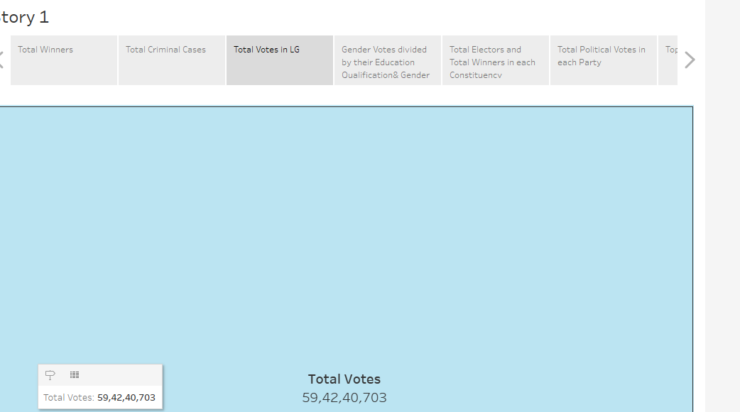

Slide 33
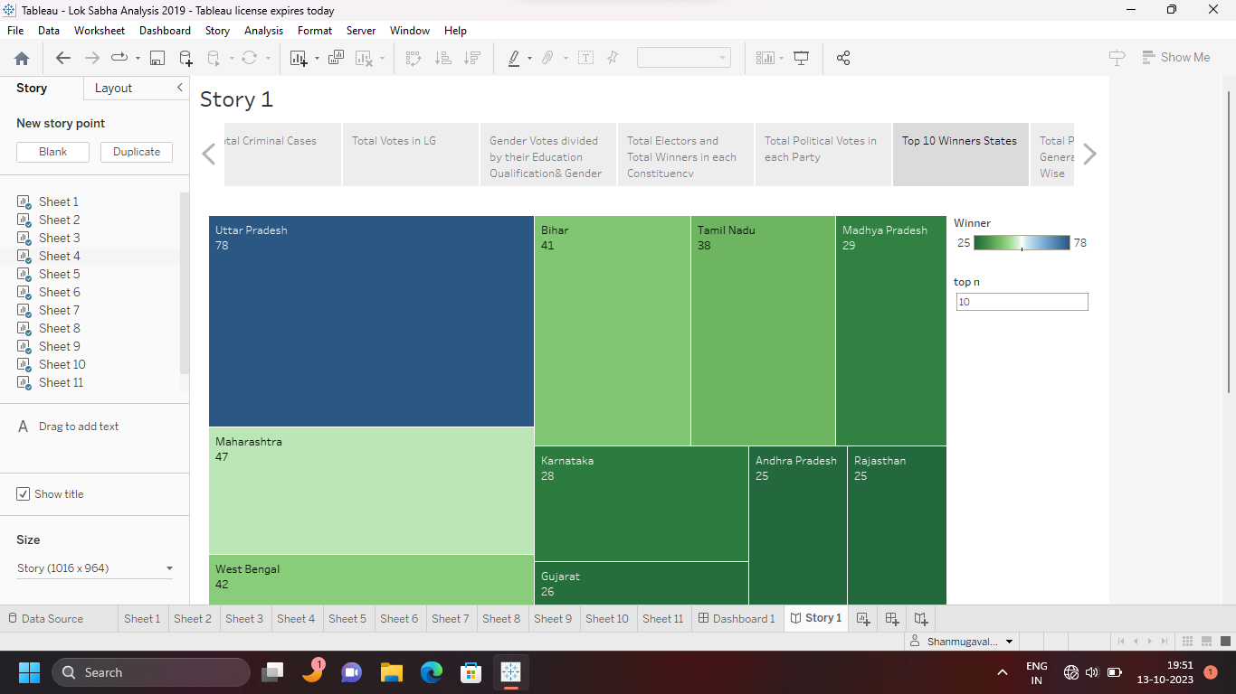

Slide 34
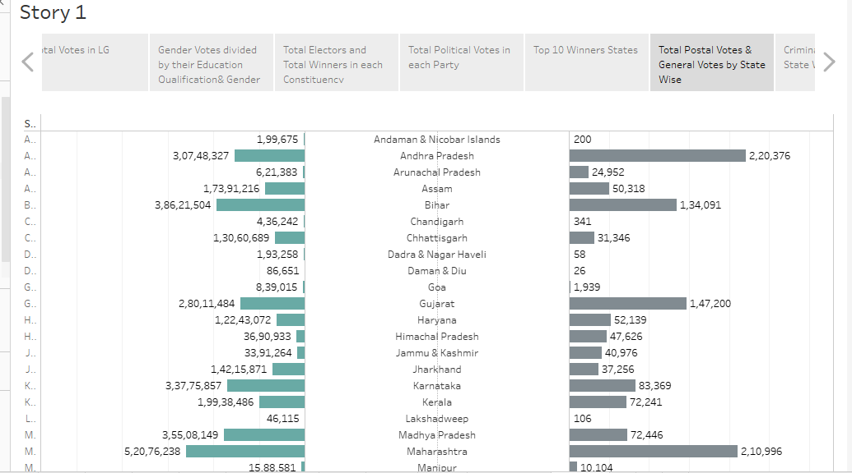

Slide 35
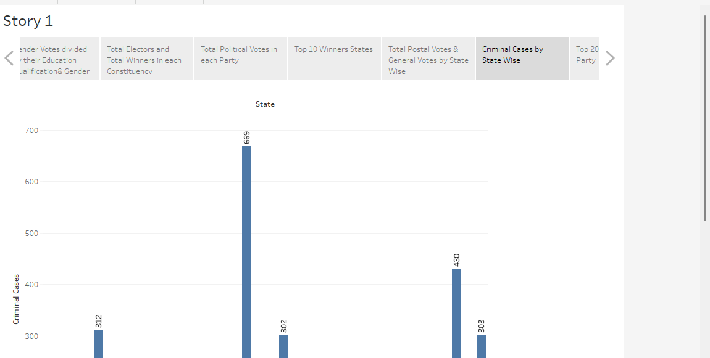

Slide 36
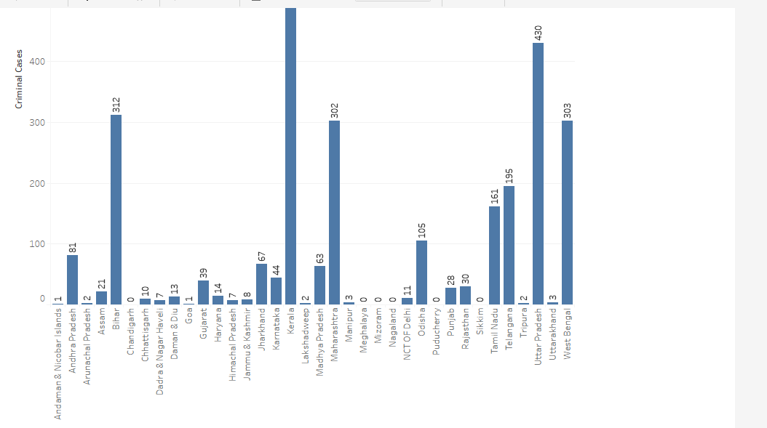

Slide 37
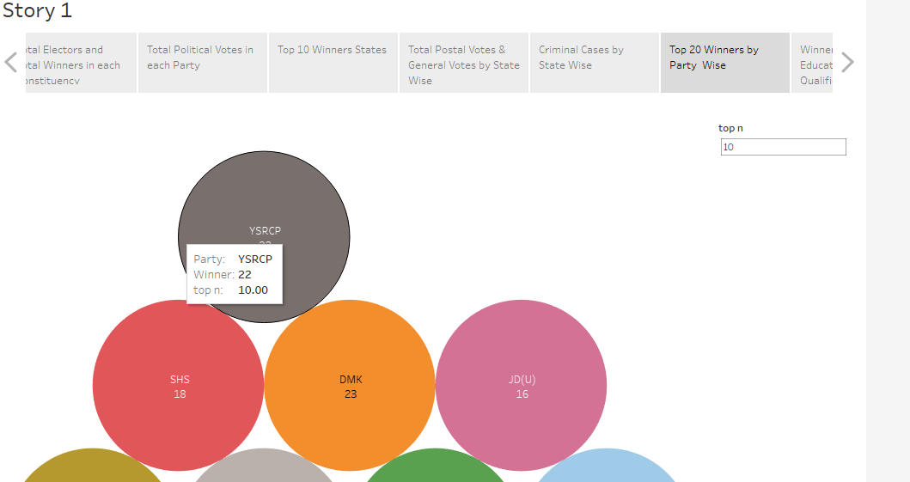

Slide 38
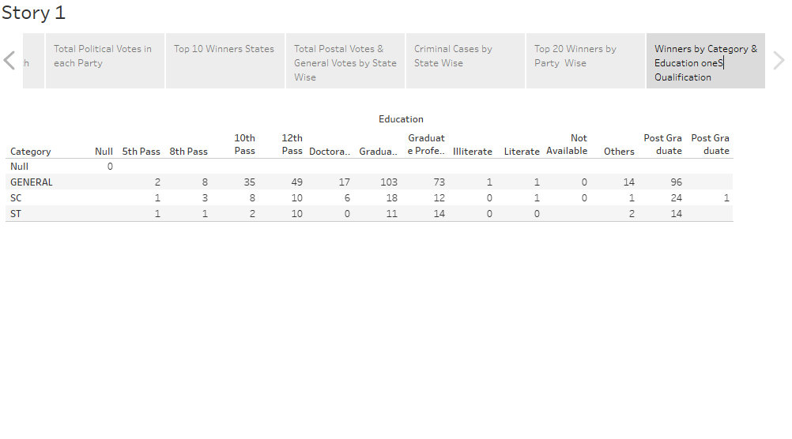

Slide 39
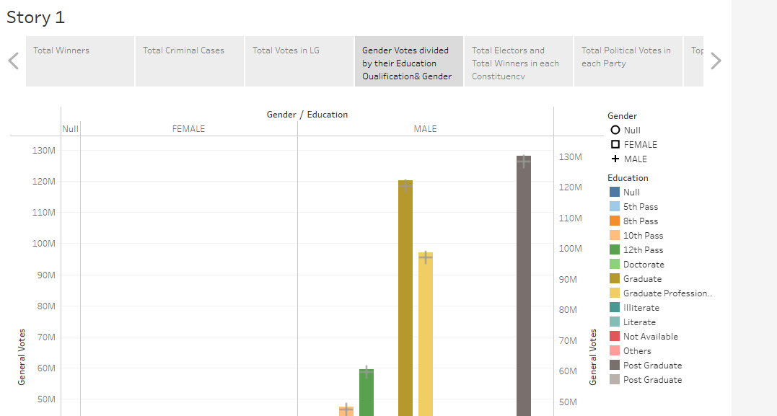

Slide 40
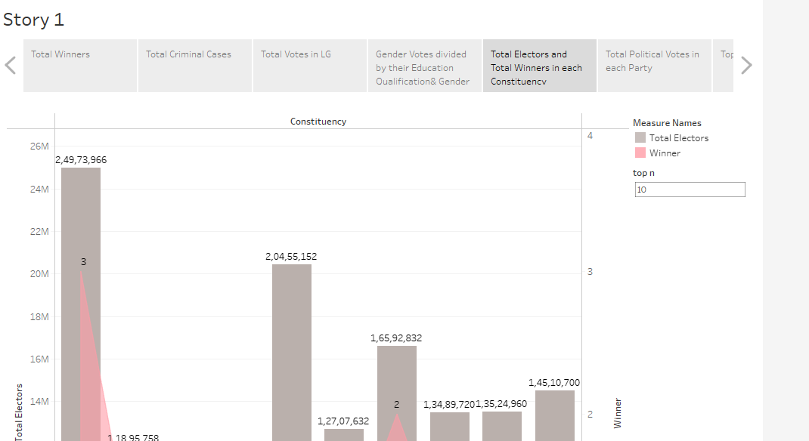

Slide 41
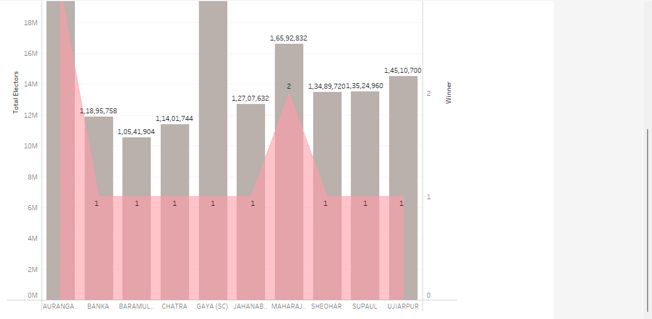

Slide 42
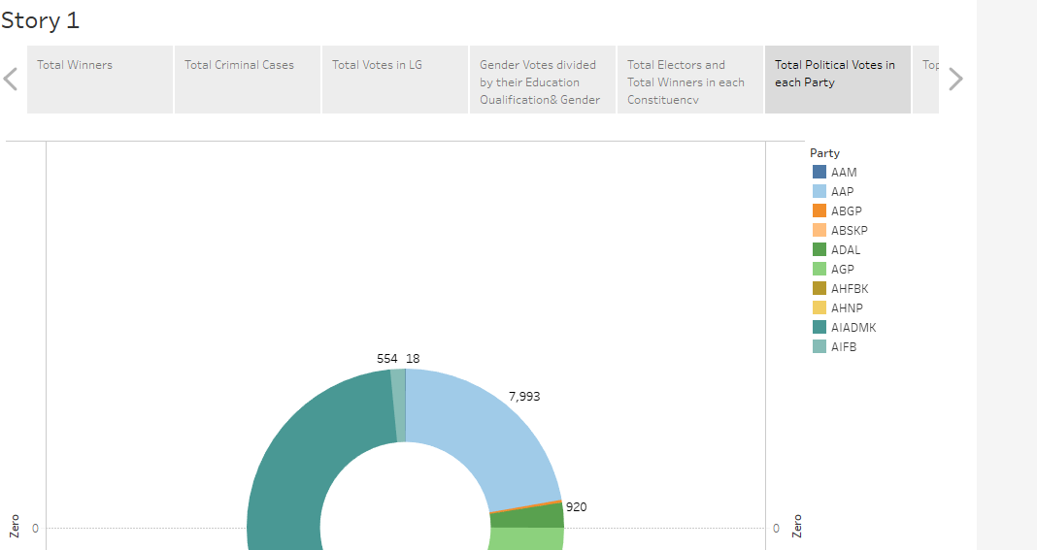

Slide 43
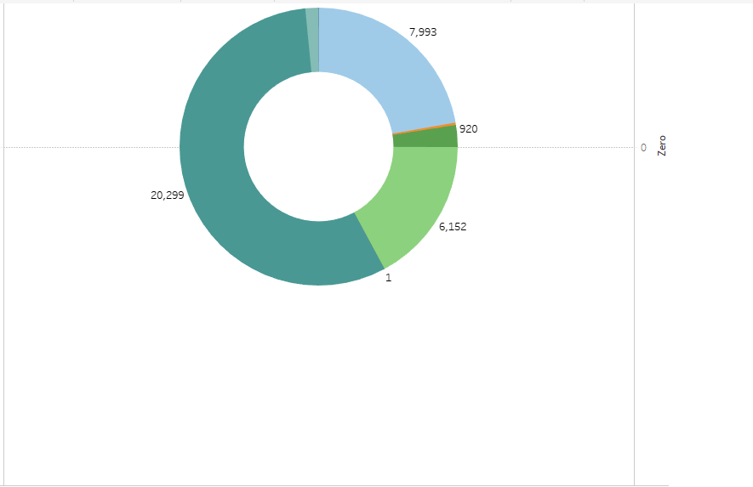

Slide 44
PUBLISHING

Slide 45
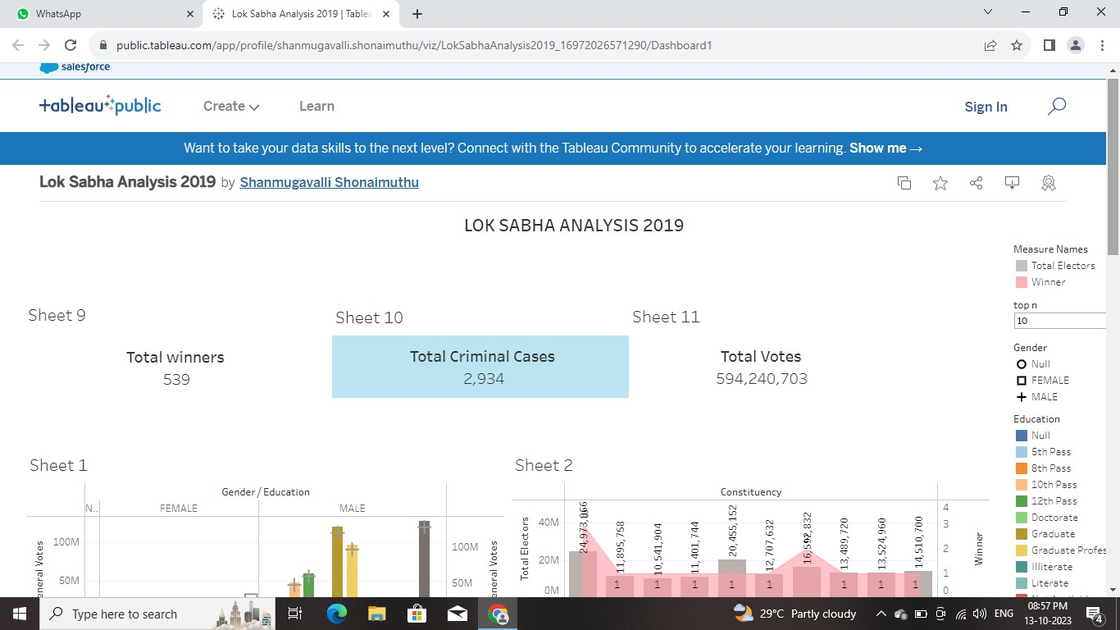

Slide 46
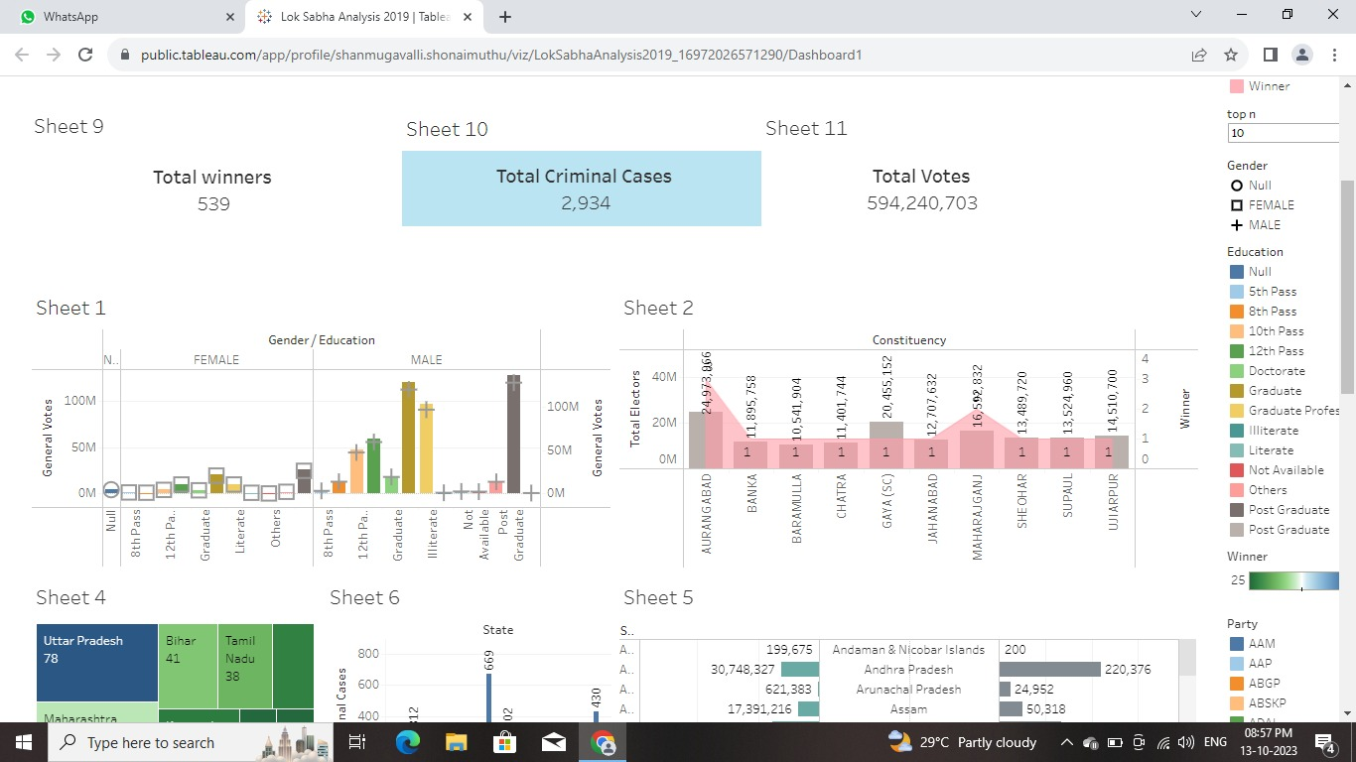

Slide 47
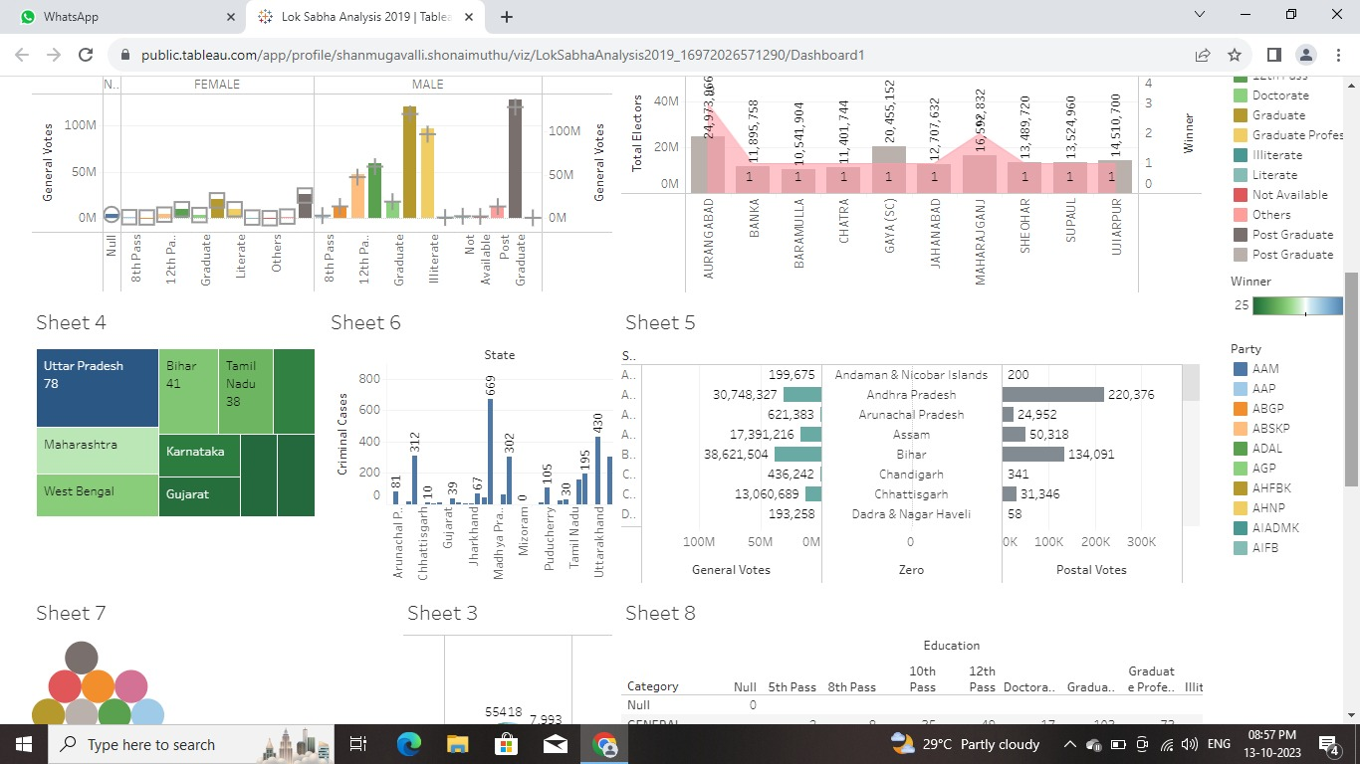

Slide 48
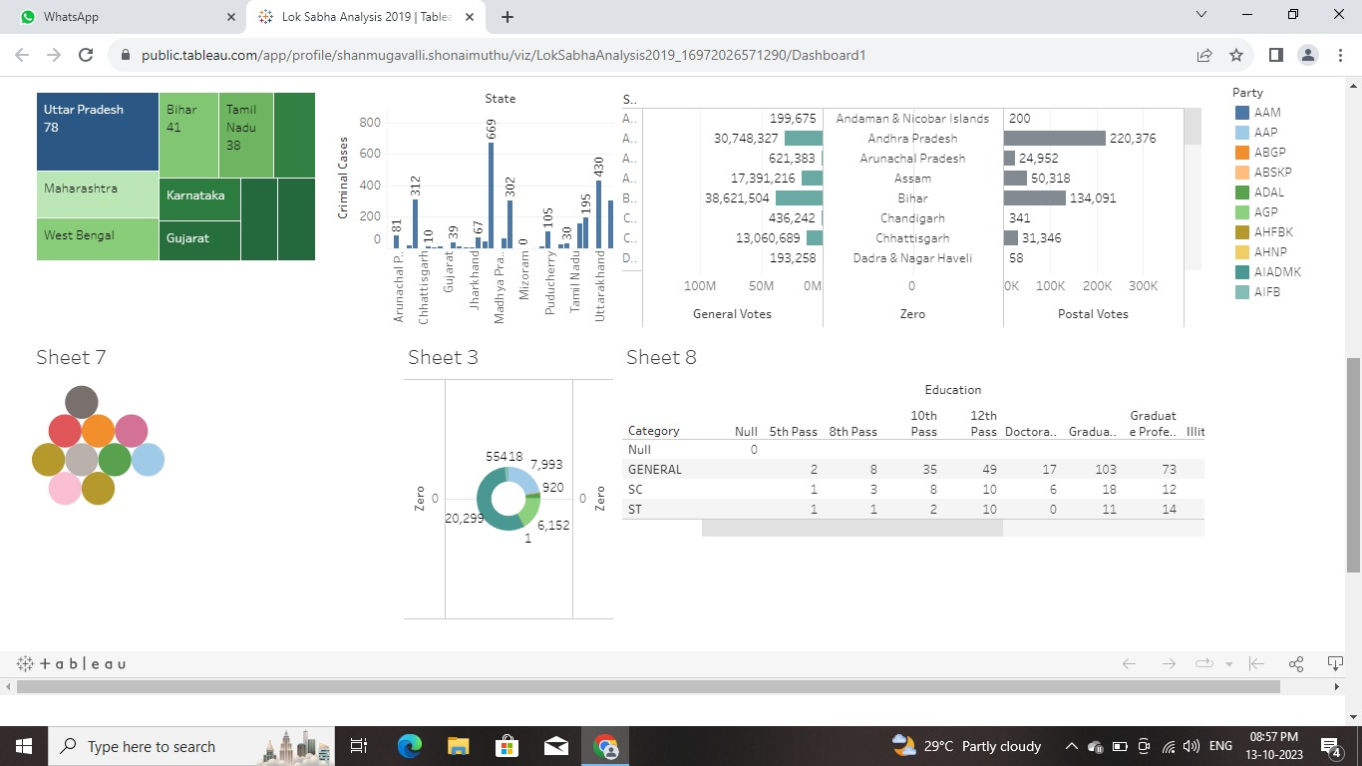

Slide 49
THANK YOU

